Slide 1
Unit IV

Slide 2
Syllabus
Intruders, Intrusion Detection and Preventing techniques, Program Security- Threats against programs, Secure programs, Viruses and other malicious code; Introduction to Operating System Security: User Authentication mechanisms, Memory and Address protection, File system protection.

Slide 3
Intrusion Detection & Prevention System(IDPS)
Intrusion: An intrusion occurs when an attacker attempts to gain entry into or disrupt the normal operations of an information system, almost always with the intent to do harm.

Slide 4
Intrusion Prevention System
Intrusion prevention consists of activities that deter an intrusion.
Some important intrusion prevention activities are writing and implementing good enterprise information security policy, planning and executing effective information security programs, installing and testing technology-based information security countermeasures (such as firewalls and intrusion detection systems), and conducting and measuring the effectiveness of employee training and awareness activities.

Slide 5
Intrusion Detection System(IDS)
Intrusion detection consists of procedures and systems that identify system intrusions.
An IDS works like a burglar alarm in that it detects a violation (some system activity analogous to an opened or broken window) and activates an alarm.
This alarm can be audible and/or visual (producing noise and lights, respectively), or it can be silent (an e-mail message or pager alert).
With almost all IDSs, system administrators can choose the configuration of the various alerts and the alarm levels associated with each type of alert.

Slide 6
IDPS Terminology
In order to understand IDPS operational behavior, you must first become familiar with some IDPS terminology:
Alert or alarm: An indication that a system has just been attacked or is under attack. IDPS alerts and alarms take the form of audible signals, e-mail messages, pager notifications, or pop-up windows.
Evasion: The process by which attackers change the format and/or timing of their activities to avoid being detected by the IDPS.
False attack stimulus: An event that triggers an alarm when no actual attack is in progress. Scenarios that test the configuration of IDPSs may use false attack stimuli to determine if the IDPSs can distinguish between these stimuli and real attacks.
False negative: The failure of an IDPS to react to an actual attack event. This is the most grievous failure, since the purpose of an IDPS is to detect and respond to attacks.
False positive: An alert or alarm that occurs in the absence of an actual attack. A false positive can sometimes be produced when an IDPS mistakes normal system activity for an attack. False positives tend to make users insensitive to alarms and thus reduce their reactivity to actual intrusion events.
Noise: Alarm events that are accurate and noteworthy but that do not pose significant threats to information security. Unsuccessful attacks are the most common source of IDPS noise, and some of these may in fact be triggered by scanning and enumeration tools deployed by network users without intent to do harm.

Slide 7
Site policy: The rules and configuration guidelines governing the implementation and operation of IDPSs within the organization.
Site policy awareness: An IDPS’s ability to dynamically modify its configuration in response to environmental activity. A so-called smart IDPS can adapt its reactions in response to administrator guidance over time and circumstances of the current local environment.
True attack stimulus: An event that triggers alarms and causes an IDPS to react as if a real attack is in progress. The event may be an actual attack, in which an attacker is at work on a system compromise attempt, or it may be a drill, in which security personnel are using hacker tools to conduct tests of a network segment.
Tuning: The process of adjusting an IDPS to maximize its efficiency in detecting true positives, while minimizing both false positives and false negatives.
Confidence value: The measure of an IDPS’s ability to correctly detect and identify certain types of attacks. The confidence value an organization places in the IDPS is based on experience and past performance measurements.
Alarm filtering: The process of classifying IDPS alerts so that they can be more effectively managed. An IDPS administrator can set up alarm filtering by running the system for a while to track what types of false positives it generates and then adjusting the alarm classifications.
Alarm clustering and compaction: A process of grouping almost identical alarms that happen at close to the same time into a single higher-level alarm. This consolidation reduces the number of alarms generated, thereby reducing administrative overhead, and also identifies a relationship among multiple alarms.

Slide 8
Why use an IDPS?
According to the NIST documentation on industry best practices, there are several compelling reasons to acquire and use an IDPS:
1. To prevent problem behaviors by increasing the perceived risk of discovery and punishment for those who would attack or otherwise abuse the system.
2. To detect attacks and other security violations that are not prevented by other security measures.
3. To detect and deal with the preambles to attacks (commonly experienced as network probes and other “doorknob rattling” activities).
4. To document the existing threat to an organization.
5. To act as quality control for security design and administration, especially in large and complex enterprises.
6. To provide useful information about intrusions that do take place, allowing improved diagnosis, recovery, and correction of causative factors

Slide 9
Types of IDPS
There are two types of IDPS:
- Network-based IDPS(NIDPS)
- Host-based IDPS(HIDPS)
A network-based IDPS is focused on protecting network information assets. Two specialized subtypes of network-based IDPS are the wireless IDPS and the network behavior analysis (NBA) IDPS. The wireless IDPS focuses on wireless networks, as the name indicates, while the NBA IDPS examines traffic flow on a network in an attempt to recognize abnormal patterns like DDoS, malware, and policy violations.
A host-based IDPS protects the server or host’s information assets. It monitors both network connection activity and current information states on host servers. The application-based model works on one or more host systems that support a single application and defends that specific application from special forms of attack.

Slide 10
NIDPS
Network-Based IDPS A network-based IDPS (NIDPS) resides on a computer or appliance connected to a segment of an organization’s network and monitors network traffic on that network segment, looking for indications of ongoing or successful attacks.
When the NIDPS identifies activity that it is programmed to recognize as an attack, it responds by sending notifications to administrators.
When examining incoming packets, an NIDPS looks for patterns within network traffic such as large collections of related items of a certain type—which could indicate that a denial-of-service attack is underway—or the exchange of a series of related packets in a certain pattern—which could indicate that a port scan is in progress.
An NIDPS can detect many more types of attacks than a host-based IDPS, but it requires a much more complex configuration and maintenance program.
A NIDPS is installed at a specific place in the network (such as on the inside of an edge router) from where it is possible to monitor the traffic going into and out of a particular network segment.

Slide 11
HIDPS
Host-Based IDPS While a network-based IDPS resides on a network segment and monitors activities across that segment, a host-based IDPS (HIDPS) resides on a particular computer or server, known as the host, and monitors activity only on that system.
HIDPSs are also known as system integrity verifiers because they benchmark and monitor the status of key system files and detect when an intruder creates, modifies, or deletes monitored files.
An HIDPS has an advantage over an NIDPS in that it can access encrypted information traveling over the network and use it to make decisions about potential or actual attacks.
Also, since the HIDPS works on only one computer system, all the traffic it examines traverses that system.
An HIDPS is also capable of monitoring system configuration databases, such as windows registries, in addition to stored configuration files like .ini, .cfg, and .dat files. Most HIDPSs work on the principle of configuration or change management, which means that they record the sizes, locations, and other attributes of system files.

Slide 12
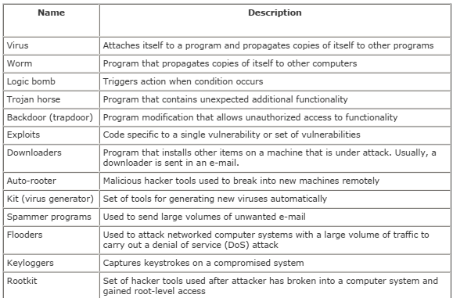
Terminologies of Malicious Program

Slide 13
Viruses
A virus is a piece of software that can infect other programs by modifying them; the modification includes a copy of the virus program, which can then go on to infect other programs.
A virus can do anything that other programs do. The only difference is that it attaches itself to another program and executes secretly when the host program is run. Once a virus is executing, it can perform any function, such as erasing files and programs.

Slide 14
Contd…
During its lifetime, a typical virus goes through the following four phases: 1. Dormant phase: The virus is idle. The virus will eventually be activated by some event, such as a date, the presence of another program or file, or the capacity of the disk exceeding some limit. Not all viruses have this stage.
2. Propagation phase: The virus places an identical copy of itself into other programs or into certain system areas on the disk. Each infected program will now contain a clone of the virus, which will itself enter a propagation phase.
3. Triggering phase: The virus is activated to perform the function for which it was intended. As with the dormant phase, the triggering phase can be caused by a variety of system events, including a count of the number of times that this copy of the virus has made copies of itself.
4. Execution phase: The function is performed. The function may be harmless, such as a message on the screen, or damaging, such as the destruction of programs and data files.
Most viruses carry out their work in a manner that is specific to a particular operating system and, in some cases, specific to a particular hardware platform. Thus, they are designed to take advantage of the details and weaknesses of particular systems.

Slide 15
Types of Viruses
Parasitic virus: The traditional and still most common form of virus. A parasitic virus attaches itself to executable files and replicates, when the infected program is executed, by finding other executable files to infect.
Memory-resident virus: Lodges in main memory as part of a resident system program. From that point on, the virus infects every program that executes.
Boot sector virus: Infects a master boot record or boot record and spreads when a system is booted from the disk containing the virus.
Stealth virus: A form of virus explicitly designed to hide itself from detection by antivirus software.
Polymorphic virus: A virus that mutates with every infection, making detection by the "signature" of the virus impossible.
Metamorphic virus: As with a polymorphic virus, a metamorphic virus mutates with every infection. The difference is that a metamorphic virus rewrites itself completely at each iteration, increasing the difficulty of detection. Metamorphic viruses may change their behavior as well as their appearance.

Slide 16
Firewall
A firewall forms a barrier through which the traffic going in each direction must pass. A firewall security policy dictates which traffic is authorized to pass in each direction.
A firewall may be designed to operate as a filter at the level of IP packets, or may operate at a higher protocol layer.

Slide 17
Types of Firewall
There are three types of Firewall:
Packet Filtering Firewall
Application Level Gateway
Circuit Level Gateway

Slide 18
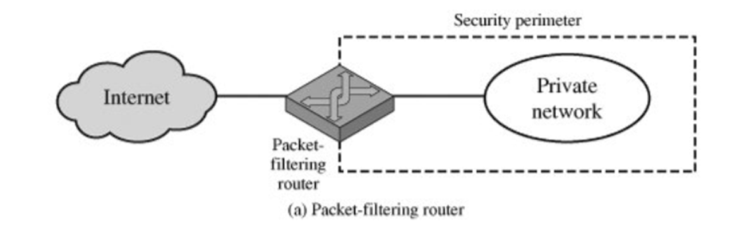
Packet-Filtering Router
A packet-filtering router applies a set of rules to each incoming and outgoing IP packet and then forwards or discards the packet.
The router is typically configured to filter packets going in both directions (from and to the internal network). Filtering rules are based on information contained in a network packet.

Slide 19
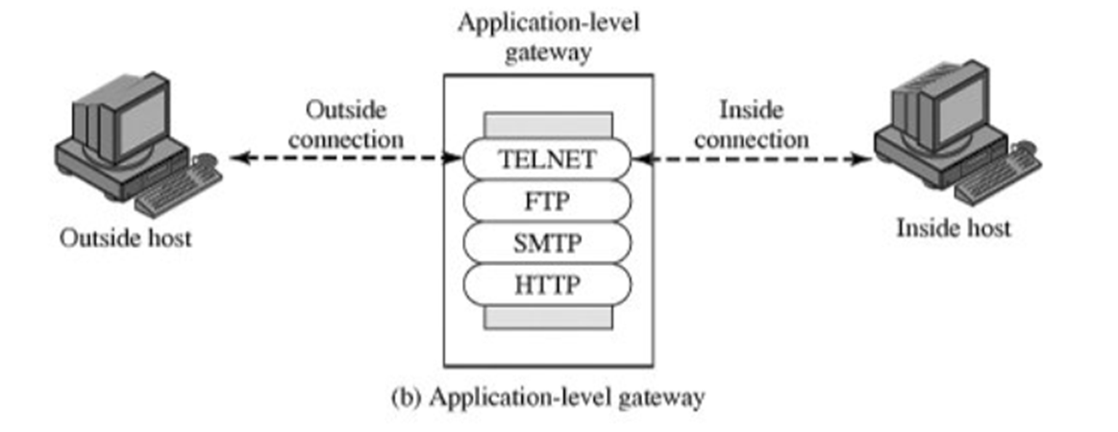
Application-Level Gateway
An application-level gateway, also called a proxy server, acts as a relay of application-level traffic. The user contacts the gateway using a TCP/IP application, such as Telnet or FTP, and the gateway asks the user for the name of the remote host to be accessed.
When the user responds and provides a valid user ID and authentication information, the gateway contacts the application on the remote host and relays TCP segments containing the application data between the two endpoints. If the gateway does not implement the proxy code for a specific application, the service is not supported and cannot be forwarded across the firewall.
Application-level gateways tend to be more secure than packet filters. Rather than trying to deal with the numerous possible combinations that are to be allowed and forbidden at the TCP and IP level, the application-level gateway need only scrutinize a few allowable applications. In addition, it is easy to log and audit all incoming traffic at the application level.
A prime disadvantage of this type of gateway is the additional processing overhead on each connection.

Slide 20
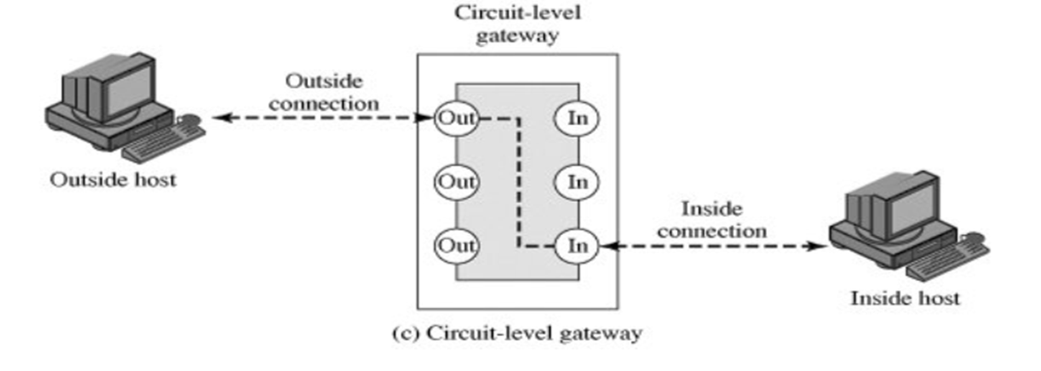
Circuit-Level Gateway
A circuit-level gateway can be a stand-alone system or it can be a specialized function performed by an application-level gateway for certain applications.
A circuit-level gateway does not permit an end-to-end TCP connection; rather, the gateway sets up two TCP connections, one between itself and a TCP user on an inner host and one between itself and a TCP user on an outside host.
Once the two connections are established, the gateway typically relays TCP segments from one connection to the other without examining the contents. The security function consists of determining which connections will be allowed.

Slide 21
Memory and Address Protection
Memory protection includes protection for the memory that the OS itself uses as well as the memory of user processes.
Major challenge in multi-programming system is to prevent one program from affecting the data and programs in the memory space of other users.

Slide 22
The various methods for memory and address protection are:
i. Fence:
A fence or fence address is simplest form of memory protection which can be used only for single user operating system.
A fence is a particular address that users and their processes cannot cross. Only the OS can operate on one side of the fence and users are restricted to the other side.
A fence could be static, in which case there is a fixed fence address. Alternatively, a dynamic fence can be used, which can be implemented using a fence register to specify the current fence address.
ii. Base and Bounds registers:
This type of protection can be used in multi- user environment where one users program needs to be protected from the other.
Each user has a base register which is the lower address and a Bound register which is the upper address limit.
The base and bounds register approach implicitly assumes that the user or process space is contiguous in memory. The OS must determine what protection to apply to a specific memory location.
In some cases it might be sufficient to apply the same protection to all of a user's memory.
The disadvantage is that the registers confine access to consecutive range of addresses.

Slide 23
iii. Tagging:
This specifies the protection for each individual address. In this method of protection every word of machine memory has one or more extra bits to identify the access rights to that word.
Only privileged instructions can set these access bits. While this is as fine-grained protection as possible, it introduces significant overhead.
The overhead can be reduced by tagging sections of the address space instead of each individual address. Another drawback to tagging is compatibility, since tagging schemes are not in common use.
iv. Segmentation:
This method divides the memory into logical units such as individual procedures or the data in one array.
Once they are divided, appropriate access control can be enforced on each segment.
A benefit of segmentation is that any segment can be placed in any memory location provided the location is large enough to hold it. The OS must keep track of the locations of all segments, which is accomplished using <segment,offset> pairs, where the named segment specifies the segment, and the offset is the starting address of the specified segment.
With segmentation, all address references must go through the OS, so the OS can, in this respect, achieve complete mediation. Depending on the access control applied to particular segments, users can share access to some segments or users can be restricted to specific segments.

Slide 24
v. Paging:
Paging discards the disadvantage of segmentation. In paging all segments are of a fixed size called as pages and the memory divided is known as page frames.
In paging a particular page can be accessed using a pair of the form <page, offset=""> where page is the page number and offset is location within a page.
The advantages of paging over segmentation include no fragmentation, improved efficiency, and the fact that there are no variable sizes to worry about.
The disadvantages are that there is, in general, no logical unity to pages, which makes it more difficult to determine the proper access control to apply to a given page.

Slide 25
Scanning and Analysis Tools
Port Scanners: Port scanning utilities, or port scanners, are tools used by both attackers and defenders to identify (or fingerprint) the computers that are active on a network, as well as the ports and services active on those computers, the functions and roles the machines are fulfilling, and other useful information. A port is a network channel or connection point in a data communications system. there are 65,536 port numbers in use for TCP and another 65,536 port numbers for UDP. Services using the TCP/IP protocol can run on any port; however, services with reserved ports generally run on ports 1–1023. Port 0 is not used. Ports greater than 1023 are typically referred to as ephemeral ports and may be randomly allocated to server and client processes. an open port can be used by an attacker to send commands to a computer, potentially gain access to a server, and possibly exert control over a networking device. The general rule of thumb is to remove from service or secure any port not absolutely necessary to conducting business. For example, if a business doesn’t host Web services, there is no need for port 80 to be available on its servers.
Operating System Detection Tools: Detecting a target computer’s operating system is very valuable to an attacker, because once the OS is known, all of the vulnerabilities to which it is susceptible can easily be determined. There are many tools that use networking protocols to determine a remote computer’s OS. One specific tool worth mentioning is XProbe, which uses ICMP to determine the remote OS.

Slide 26
Active vulnerability scanners scan networks for highly detailed information. An active scanner is one that initiates traffic on the network in order to determine security holes. As a class, this type of scanner identifies exposed usernames and groups, shows open network shares, and exposes configuration problems and other vulnerabilities in servers. An example of a vulnerability scanner is GFI LANguard Network Security Scanner (NSS), which is available as freeware for non-commercial use. Another example of a vulnerability scanner is Nessus, which is a professional freeware utility that uses IP packets to identify the hosts available on the network, the services (ports) they are offering, the operating system and OS version they are running, the type of packet filters and firewalls in use, and dozens of other characteristics of the network.
Packet Sniffers: A packet sniffer (sometimes called a network protocol analyzer) is a network tool that collects copies of packets from the network and analyzes them. It can provide a network administrator with valuable information for diagnosing and resolving networking issues. In the wrong hands, however, a sniffer can be used to eavesdrop on network traffic. An excellent free, client-based network protocol analyzer is Wireshark , formerly known as Ethereal. Wireshark allows the administrator to examine data from both live network traffic and captured traffic. Wireshark has several features, including a language filter and TCP session reconstruction utility.

